Slide 1

SMART WORLD
MEMBERS
Sharan Kumar
Soumya P
Ruthwik D
Aarti Malhotra
Neel Mani Pandit
Lakshman K

Slide 2

BUSINESS OBJECTIVE
Overall Business Objective:
• The objective of our analysis is to gain insights from the provided sample for optimisation of business performance.
• Our focus is to understand various trends such as sales, profitability, customer behaviour, product performance.
• By doing so, we aim to identify opportunities for revenue growth, cost optimisation, and customer retention.

Slide 3

BUSINESS OBJECTIVE
Understanding of the problem:
• The problem at hand is to analyse the sales and customer data for a retail company operating in various regions and selling products in different categories.
• The company aims to extract meaningful insights and from the data to address key business challenges.
• These include identifying the top-performing products and regions, understanding customer segments, optimizing shipping cost, and exploring opportunities for profit optimisation.

Slide 4

BUSINESS OBJECTIVE
Approach
• Data Collection & Cleaning
• Exploratory Data Analysis (EDA)
• Customer Segmentation
• Sales Forecasting
• Profitability
• Shipping Cost
• Recommendation and Insights

Slide 5





DATA HEALTH REVIEW
NO NULL VALUES WERE FOUND EXCEPT FOR POSTAL CODE
NO DUPLICATE VALUES
ALL DATA IS IN CORRECT FORMAT
PERCENTAGE OF MISSING POSTAL CODE – 80.51%

Slide 6
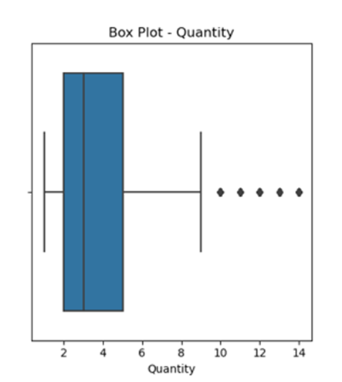
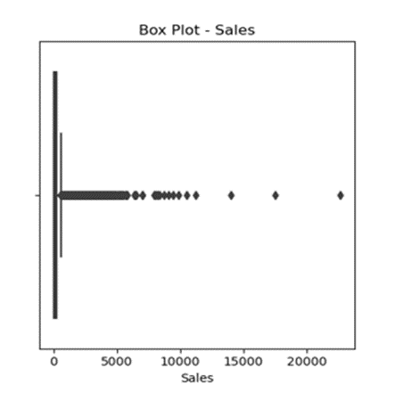
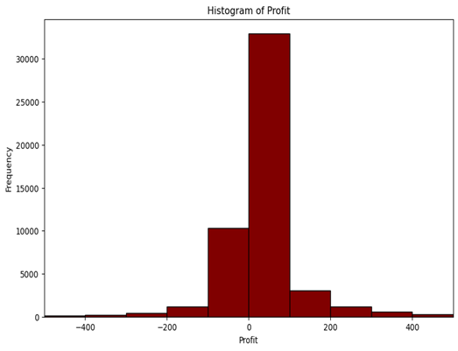
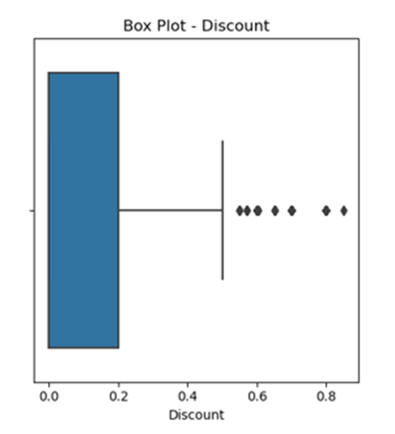
OUTLIERS IN OUR DATA

Slide 7
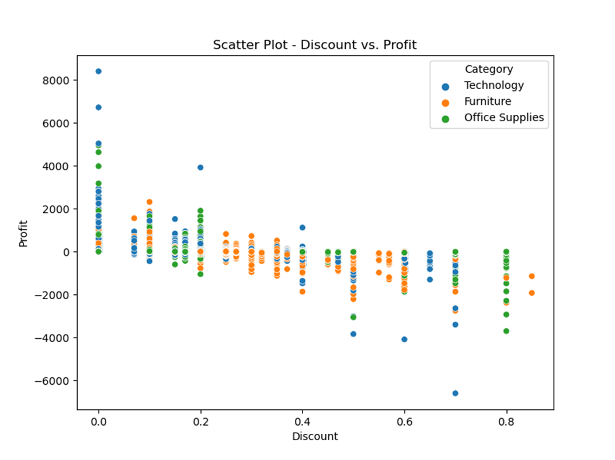
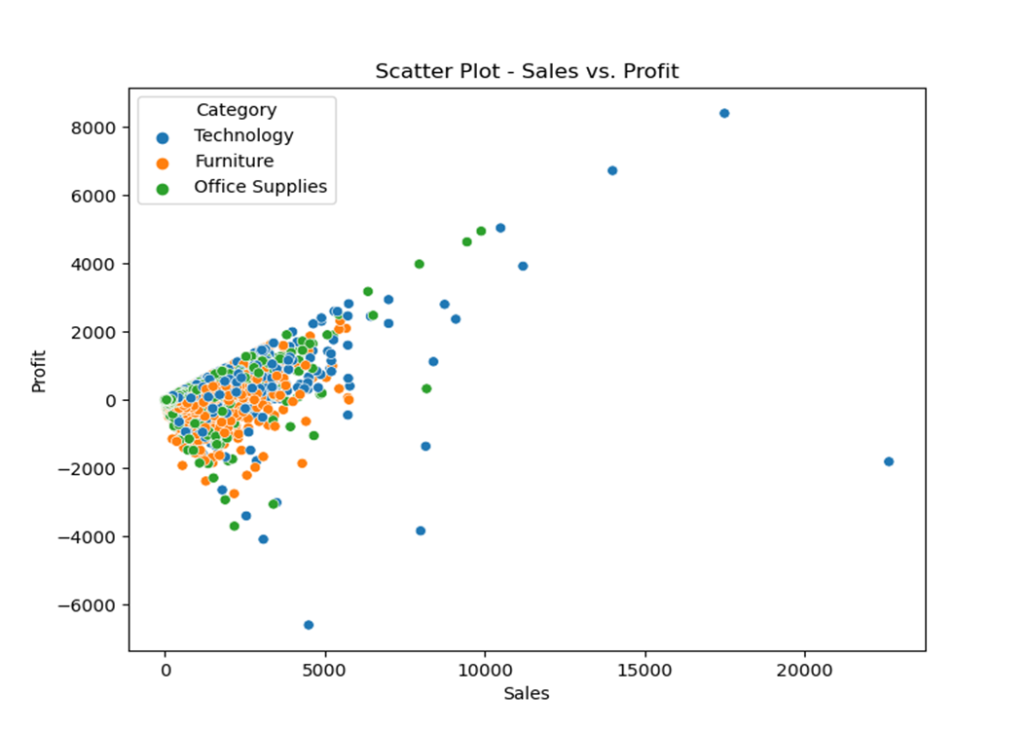
EDA - DISCOUNT VS PROFIT

Slide 8
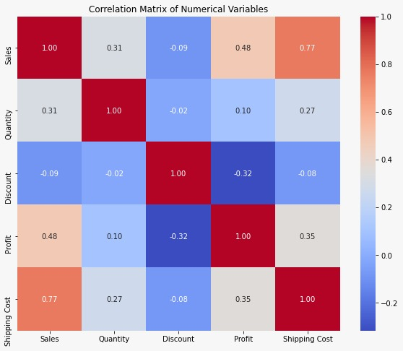
EDA – HEAT MAP

Slide 9

GRANULARITY OF DATA
• NUMBER OF UNIQUE VALUES FOR CUSTOMER ID: 17415
• NUMBER OF UNIQUE VALUES FOR ORDER ID: 25728
•NUMBER OF UNIQUE VALUES FOR PRODUCT ID: 3788
• PERCENTAGE OF REPEAT CUSTOMERS: 65%
• PERCENTAGE OF SINGLE-ORDER CUSTOMER: 35%

Slide 10
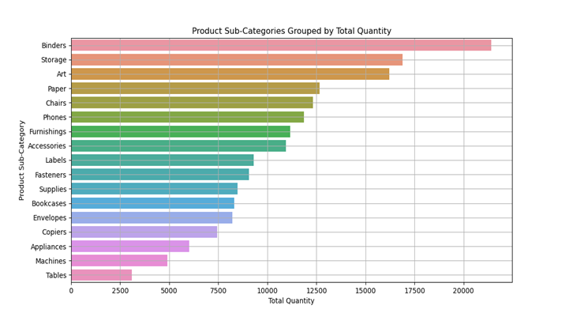
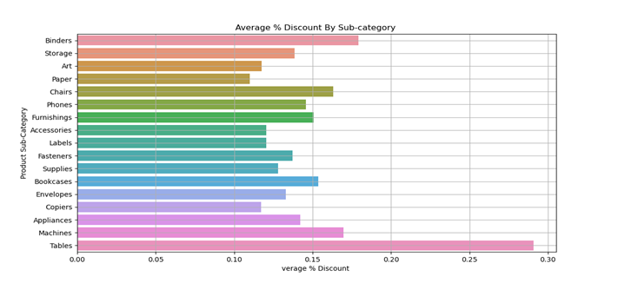
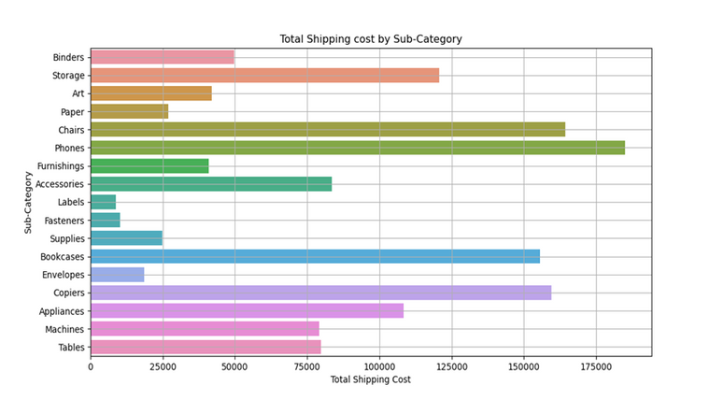
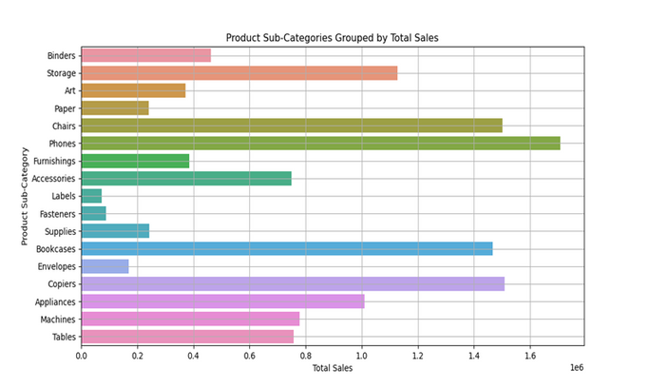
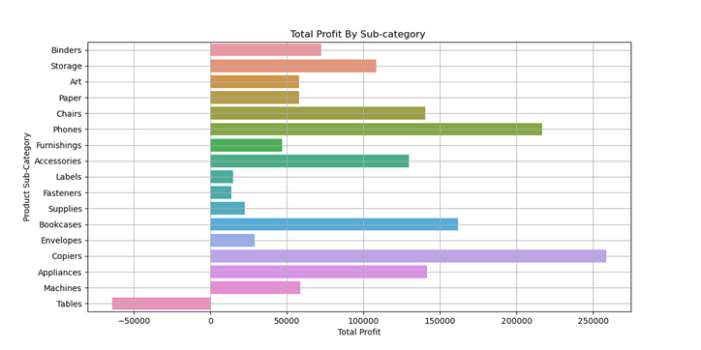
KPI METRICS

Slide 11
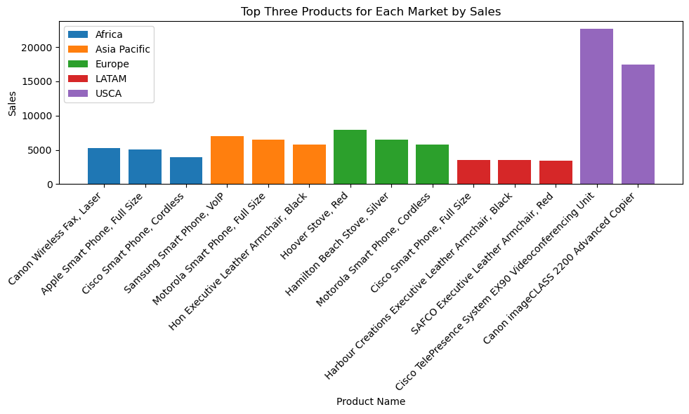
TOP 3 PERFORMING PRODUCTS BY SALES FOR EACH MARKET

Slide 12
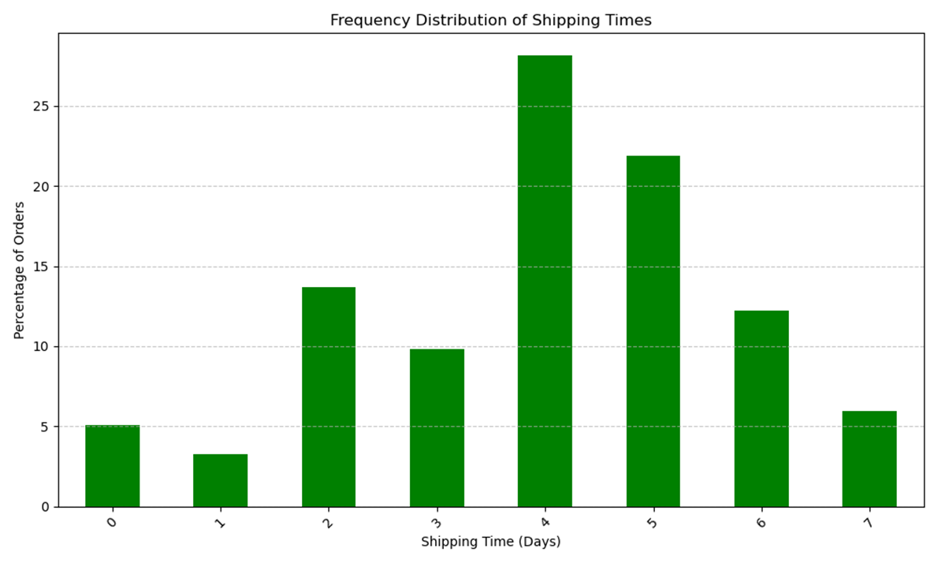
DIFFERENCE BETWEEN ORDER DAY & SHIPPING DAY

Slide 13
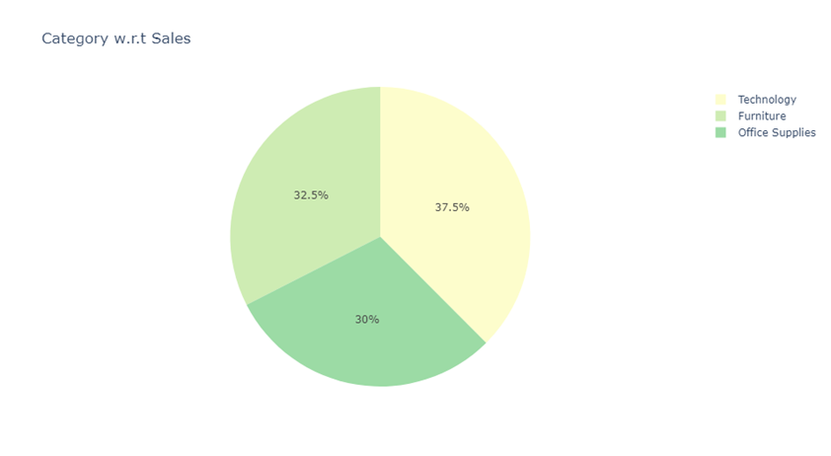
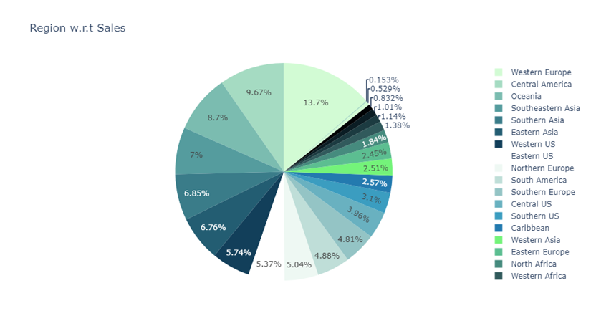
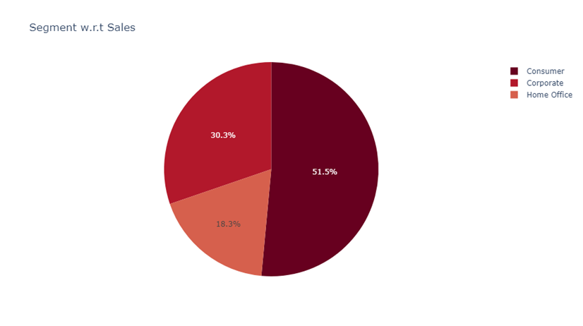
COMPARISON OF SALES WITH DIFFERENT VARIABLES

Slide 14
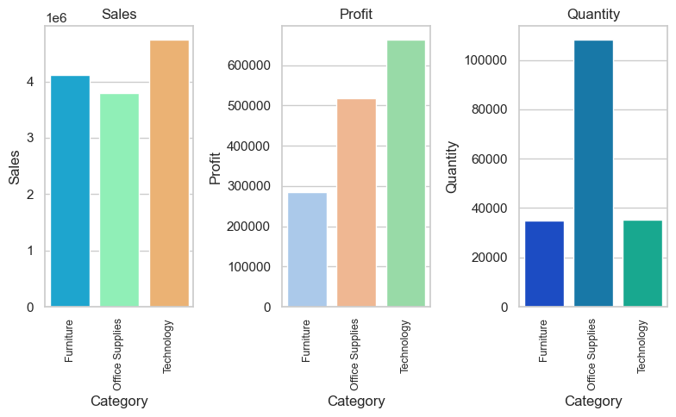
CATEGORY WISE SALE DISTRIBUTION

Slide 15
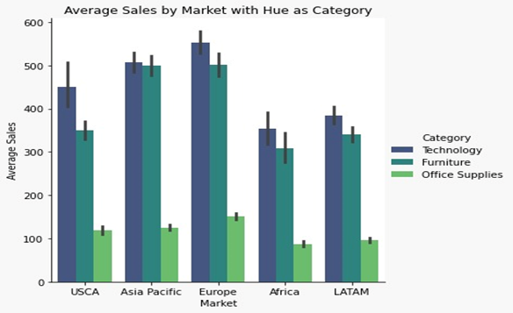
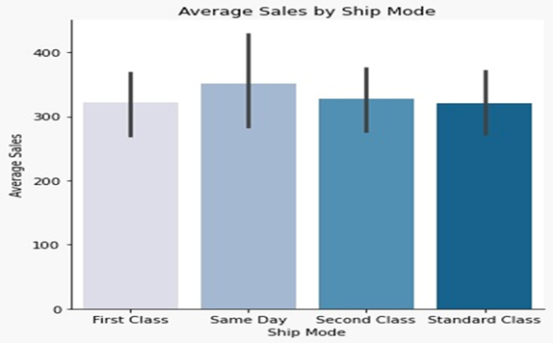
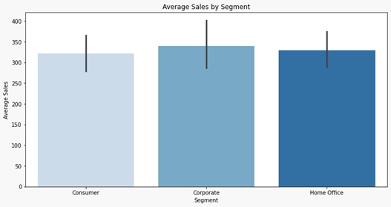
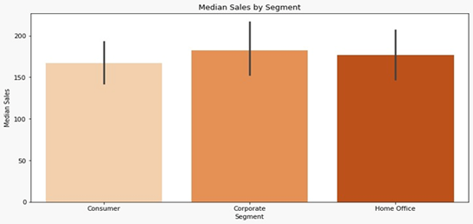
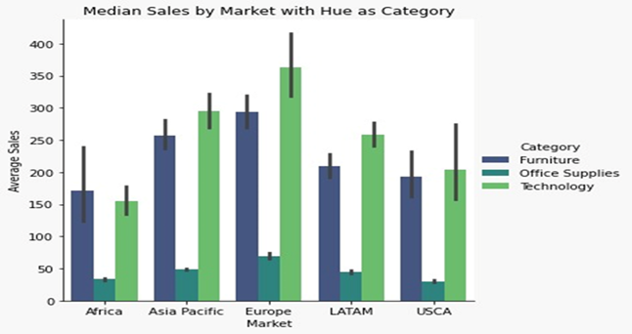
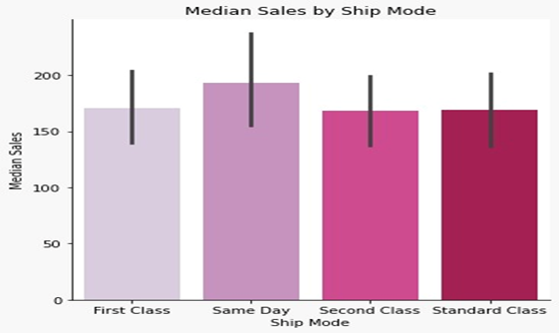

Slide 16
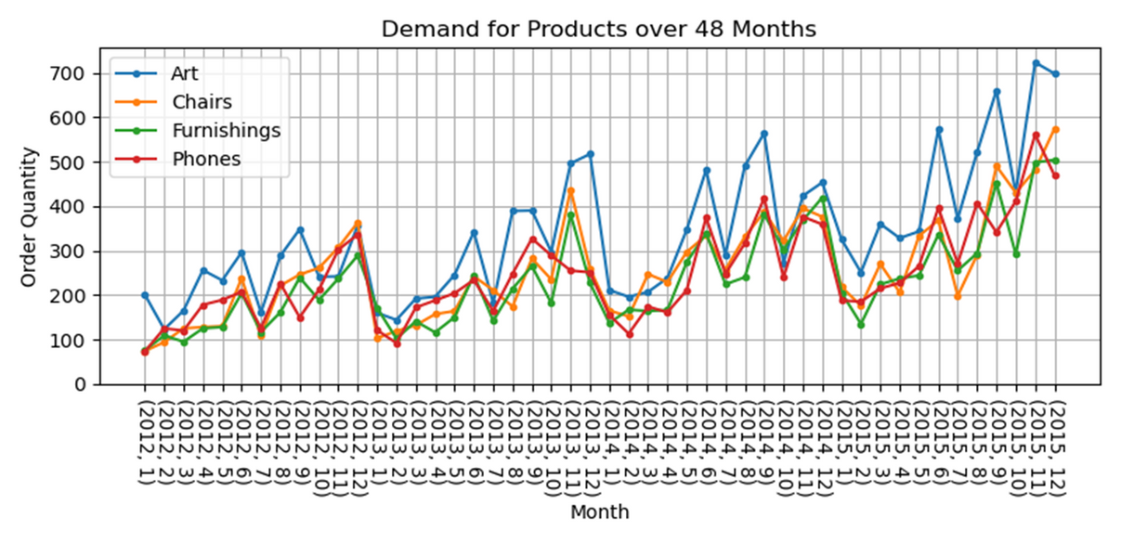
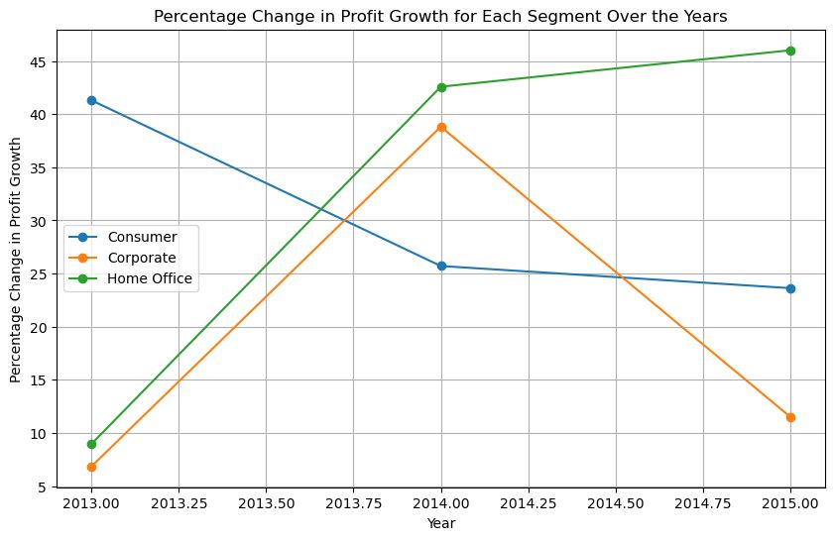

Slide 17

From the data we can see that how vast business is (165 countries out of 193 countries, there are 23 regions).
The business is covering around 5 markets in the globally.
We get to know that company is targeting urban region to improve further sales they can focus on rural areas(day to day products)
We need to reduce our discount on furniture to improve our profits.
USCA is top performing Market in technology sector with product category Machine
Even though binders are selling large in quantity there profits are not that good
We need to focus on the phones since it is producing good profits instead of giving discounts we should give offers(gifts)
We need to improve our overall shipping time

Slide 18

STRATEGIES FOR CUSTOMER RETENTION
• Personalize customer engagement
• Loyalty programs
•We should give discounts on rentals instead of sales
• Conduct feedback and surveys
• Subscriptions and auto-replenishments
• Upselling & cross-selling
• Social media engagement
• Competitive pricing

Slide 19


